Slide 1

Oracle E-Business Suite Procurement
University of Mauritius
Mrs Chhaya Jahajeeah-Suntoo
Manager MIS
Centre for Information Technology & Systems (CITS)
University of Mauritius
Email : chaya@uom.ac.mu
Date : 06 May 2026

Slide 2
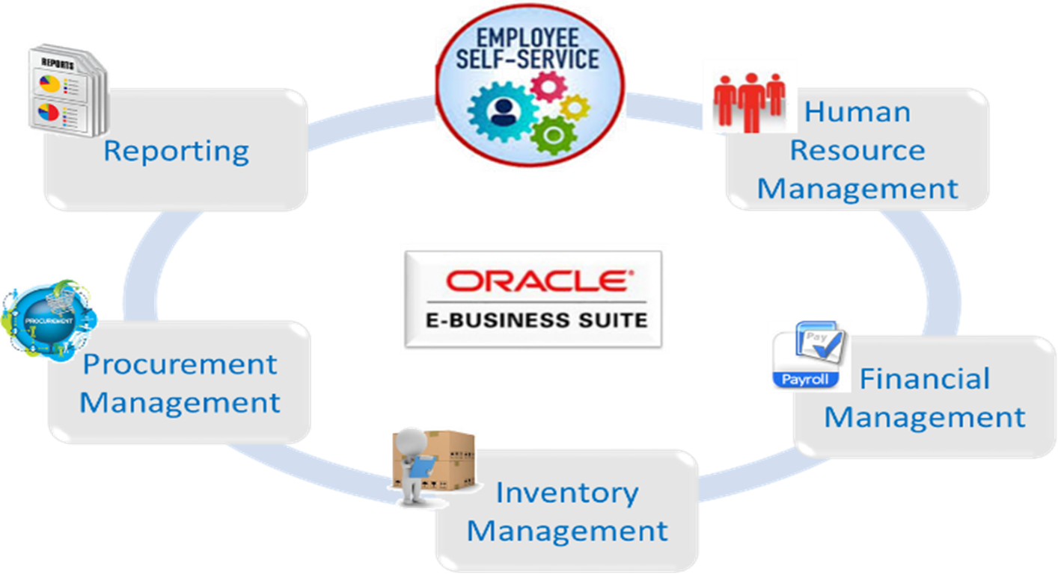
Introduction
In the year 2011, the University of Mauritius procured the Oracle E-Business Suite (EBS) to support its administrative and financial operations.

Slide 3
oRACLE EBS COMPONENTS
Current Oracle EBS components used by UoM
Oracle Procurement | Oracle Inventory Management
Oracle supplier | Oracle Purchasing
Oracle iprocurement | Oracle Human Capital Management
Oracle Financials | Core HR
Accounts payables | Payroll
Accounts receivable | Leaves Management
Fixed assets | Employee Self Service
General ledger | Various customized reports
Cash management | Various Customized modules

Slide 4
Objectives
Upgrade the current Oracle E-Business Suite R12.1.3 with Oracle Database 11gR2 version 11.2.0.3 environment to the latest supported release, including full migration of historical data, customisations, and reports.
The upgraded Oracle E-Business Suite is to be deployed on Oracle Cloud Infrastructure (OCI) as the target hosting platform.
The project shall therefore include the migration of the existing on-premise infrastructure to OCI, including application, database, storage, backup and disaster recovery (DR) configurations.

Slide 5
Objectives
The Bidder shall comply with the Data Protection Act 2017 more specifically Part VI section 36 and all applicable data protection and privacy laws and regulations.
The University of Mauritius (UoM) shall remain the Data Controller, and the Bidder shall act strictly as Data Processor.
The Bidder shall process personal data only on documented instructions from UoM and solely for the purposes of delivering the Oracle E-Business Suite upgrade and migration to OCI solution.
The successful bidder should also provide a one-off end-user training (UoM Process Owners, functional end-users, IT staff) and make provision for maintenance and support services of the upgraded system for 7 years beginning with Operational Acceptance.

Slide 6
current Oracle EBS Environment
The system constitutes of the following components:
Oracle Application R12.1.3 with Database 11gR2 version 11.2.0.3
Red Hat Enterprise Linux Server (RHEL) 5.7 OS
VMware ESXi 6.0.0 Update 3 Build 15517548 Hypervisor
IBM X3690 X5 Server
Intel CPU E7 – 2803 @ 1.73GHz (1 socket of 6 cores) Processor
Backup software being used: Veeam Backup & Replication version 12

Slide 7
Customisations/integrations
Some customisations in terms of reports and processes
Self-service feature to enable staff to download payslips and Statement of Emoluments | OFS file based integration with Cash Collection system (in-house system) and MIS EBS (in-house system) has direct database access to Oracle for synchronisation of data such as employee and leave details via Oracle Managed Data Access in Visual studio/Ms SQL Server by means of task schedulers
Passage Benefit Module | Cheque printing
Loan Management Module | Oracle financial data & Processes (including Accounts Payable, Accounts Receivables)
Payroll fast formulae | General Ledger
Bank letters | Fixed Assets Module
Automatic bank statement uploads | Inventory and Purchasing modules
WEB ADI upload from Excel | Absence Management
Request sets - Fixed Assets | Internal Requisitions
Payroll costing information mapping with Elements | More than 50 reports including FSG reports among others
The successful bidder is required to perform an assessment of all current customisations/integrations in the system. All these features will have to be present in the upgraded system.

Slide 8
Oracle Licenses
DETAILS | QTY | METRIC
Human Resources Management:
Oracle HR | 1500 | Employee Perpetual
Oracle Self Service | 1500
Oracle irecruitment | 1500
Oracle Performance Management | 1500
Oracle Learning Management | 1500 | Trainee Perpetual
Oracle Payroll | 1500 | Employee Perpetual
e-Procurement:
Oracle iProcurement | 100 | Application Users Perpetual
Oracle iSupplier Portal for Oracle Purchasing | 10
Oracle Sourcing for Oracle Purchasing | 10
Oracle Purchasing | 10
Oracle Procurement Contracts for Oracle Purchasing | 10

Slide 9
Oracle Licenses
DETAILS | QTY | METRIC
Asset Management and Tracking
Oracle Enterprise Asset Management | 20 | Application Users Perpetual
Oracle Self Service work requests for EAM | 20
Oracle Financials | 35
Oracle Inventory Management | 15
Oracle Internet expenses | 5000 | Expenses Reports Perpetual
Technical Support Services- Software Update License and Support:
Oracle Database Enterprise Edition - Name User Plus Perpetual | 25 + 25 | Named User Plus Perpetual
Oracle Database Enterprise Edition - Processor Perpetual | 2 | Processor Perpetual
Oracle Internet Application Server Enterprise Edition - Processor Perpetual | 2 | Processor Perpetual
Oracle Internet Application Server Enterprise Edition -Named User Plus Perpetual | 30 + 20 | Name User Plus Perpetual
Note: End Date of all licenses are : 27 Feb 2027

Slide 10
Oracle Licenses
UoM owns the Oracle EBS licenses
UoM annually renews the oracle support services for all its Oracle EBS modules directly with Oracle
Within the upgrade project and migration to OCI, the bidder should assess, re-evaluate and inform UoM if there is a need for additional licenses so as to ensure that the university is compliant in terms of licensing.

Slide 11
Addendum
Compliance Sheet for Data Protection, Privacy and Security Requirements for OCI Migration

Slide 12
Questions ?

Slide 13
Thank You

